Slide 1
Measuring Agreement
Miodrag Bolic
Slides are prepared from first 5 chapters of the book
P. K. Choudhary, H. N. Nagaraja,
Measuring agreement: Models, Methods and Applications, Wiley, 2017.

Slide 2
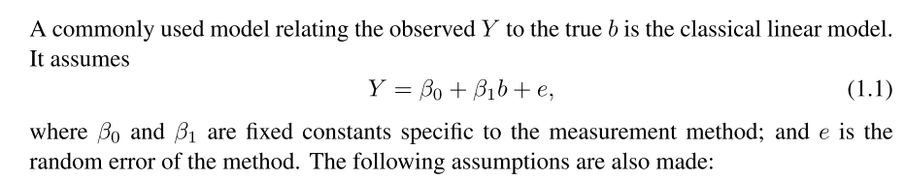
A Statistical Model for Measurements
Bias
Accuracy
Precision
Reliability

Slide 3
Goals of Method Comparison Study
To quantify the extent of agreement between the measurement methods and determine whether they have sufﬁcient agreement so that we can use them “interchangeably” for a particular purpose.
By interchangeable use we mean that a measurement from one method on a subject can be replaced by a measurement from another method without causing any difference in the practical use of the measurement.
To compare characteristics of the measurement methods—such as their biases, precisions, and sensitivities—to ﬁnd the similarities in the methods.
Measuring agreement is not the same as calibration
Notes:
In a typical calibration study, subjects with known measurements of a variable
obtained from a highly accurate method that has negligible measurement error are also
measured by a test method to develop an equation that converts a measurement from the
test method into a predicted true measurement

Slide 4
Key steps in Method Comparison
Perform exploratory data analysis
Display data graphically using scatterplot and Bland-Altman plot
Apply appropriate error model and fit the data to the model. Check goodness of fit.
Evaluate similarity between the methods
Evaluate agreement between the methods

Slide 5
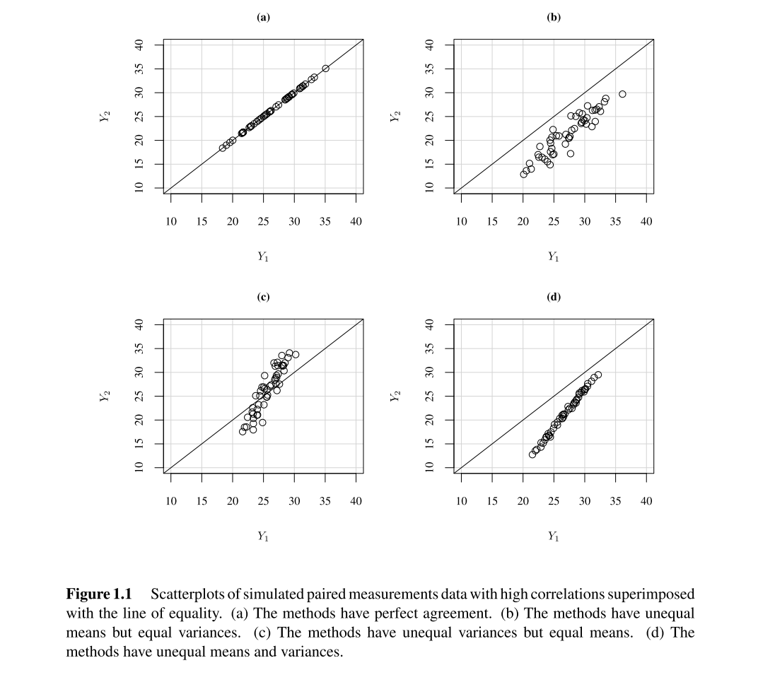


Meaning of the agreement
Perfect agreement:

Slide 6

Measurement error model
Model with reference measurement
Orthogonal distance regression (Deming regression)
Regression when both response variable Y2 and explanatory variable Y1 are measured with errors.

Slide 7


Normal model with paired measurements
Grubbs model (Mixed effect model)
Model with paired measurements
Used for comparing two methods where one measurement from each method is taken on every subject in the study. There are n subjects.

Slide 8
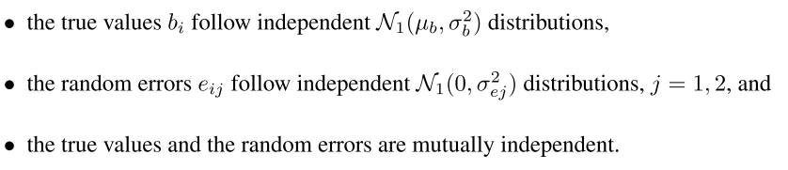

Estimating parameters of the model
Maximum likelihood estimation
Python statsmodels mixedlm

Slide 9


Estimating parameters of the model
Sometimes variance of the mixed effect model is not estimated reliably.
In this case, bivariate normal modes can be used
It can be fitted using for example fit_bivariate_normal and bivariate_normal from astroML.stats package in Python
It is related to mixed effect model as:

Slide 10




Agreement
Mean square deviation
Difference in measurements is
with mean and variance
Concordance correlation coefficient
MSD₀ is the MSD value assuming Y₁ and Y₂ are independent

Slide 11

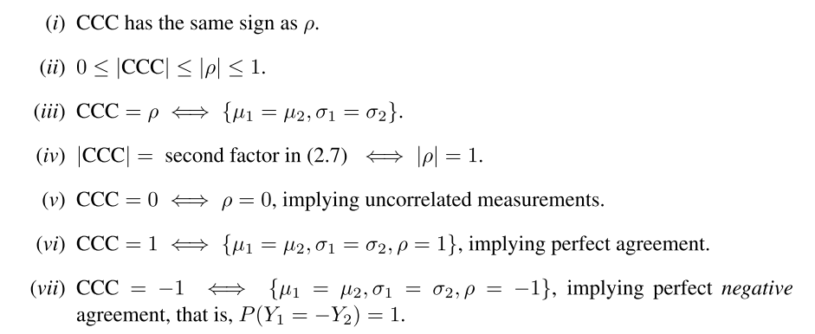
Concordance correlation coefficient

Slide 12



Lin’s Probability Criterion
Two measurement methods may be considered to have sufﬁcient agreement if a large proportion of their differences is small
δ > 0, be a speciﬁed acceptable margin for the differences in that a difference falling within ±δ is acceptably small
Total deviation index
When differences follow normal distribution:

Slide 13
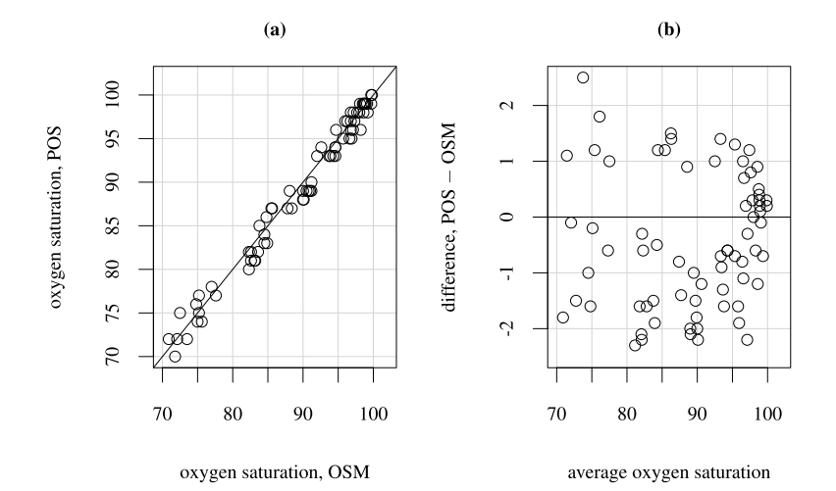
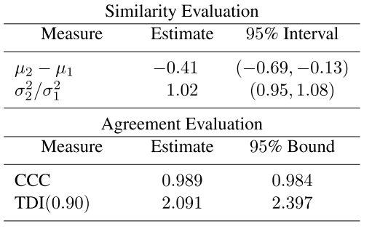
Paired measurement example (oxygen saturation 1)

Slide 14
Repeated measurements
Multiple measurements are available on each subject
Linked: when the measurements from the two methods are made together in pairs as (Y_{i1k} , Y_{i2k} ), k = 1, . . . , m_{i}
Unlinked: the measurements from the two methods are obtained separately and a method’s multiple measurements on a subject are independent replications of the same underlying measurement
Longitudinal: the measurements from both methods are made over a period of time, and unlike the linked case, there is a systematic ﬁxed effect of time or a time-dependent covariate on the measurements.
Need to evaluate repeatability of each method – self agreement

Slide 15

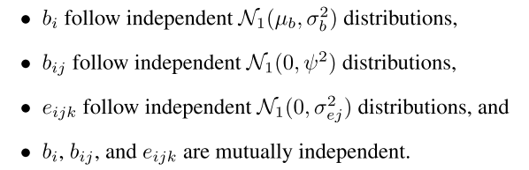
Modeling unlinked data
(Y_{i1k} , Y_{i2k} ), k = 1, . . . , m_{i}
Interaction terms are b_{i1} and b_{i2}. Here b_{i1} represents effects of method 1 on subject i.

Slide 16

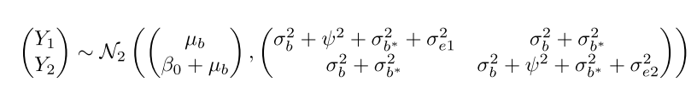
Modeling linked data
The effect b_{ik}* can also be interpreted as a subject × time interaction. In other words, b_{ik}* is a subject-speciﬁc bias that gets introduced in the measurements at time k. It follows the distribution

Slide 17

Agreement for linked paired model

Slide 18
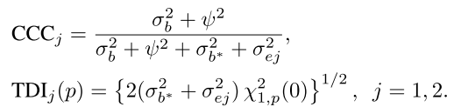
Repeatability
Repeatability of a method refers to its agreement with itself
Instead of looking for agreement between Y₁ and Y₂, we are interested in agreement between Y₁ and Y₁* as well as Y₂ and Y₂* where (Y₁*, Y₂*) is another pair of measurements taken by the two methods on the same subject.
The difference between Y₁ and Y₁* will depend only on the error e and subject × time interaction b_{ik}*

Slide 19
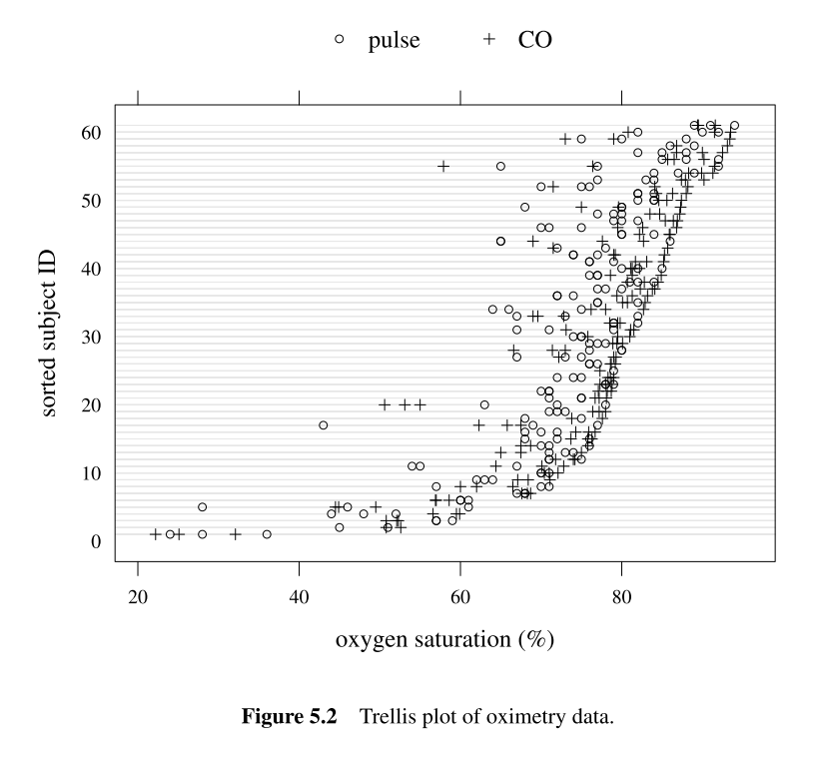
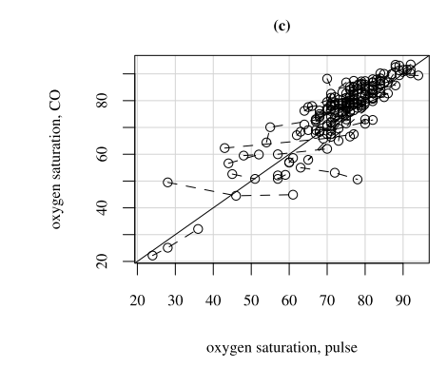
Example – Oxygen saturation 2

Slide 20
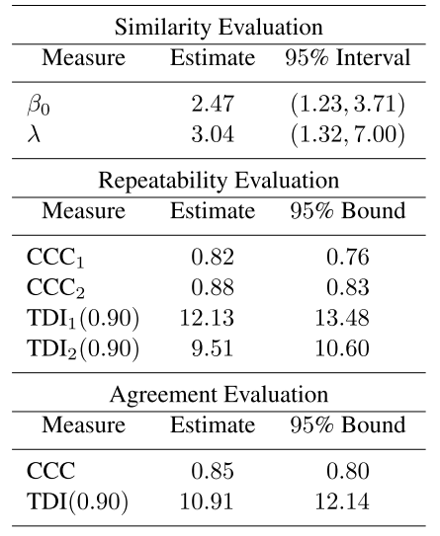
Example – Oxygen saturation 2
pulse oximetry (method 1)
CO-oximetry (method 2)
There are between one and three paired measurements over time by the two methods on each infant

